Slide 1
Got Movie? A bar code reading and movie cataloging application.
by Justin Chrysler
Advisor Jorge Novillo

Slide 2
Outline of Presentation
Where to find the code
Reason for choosing this project
Initial Goal
End Result
Reading UPC Barcode
Application Internals
Lessons Learned
Demonstration of the Application
Questions?

Slide 3
Where to find the code
Github
https://github.com/pintodragon/CS598MovieCatalog

Slide 4
Reason for choosing this project
Gain more experience with Android development
This includes a different UI layout approach
Memory management
Accessing remote services
Camera usage
Image processing

Slide 5
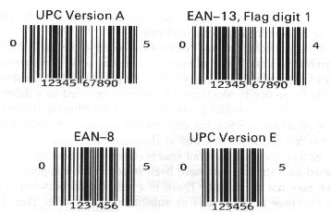
Initial Goal
Ability to read all 1D product bar codes
Remote server synchronization
Originally plan was for a “Social” application
Ability to share wishlist
Create Categories
Sort movies
Notes:
Server Sync was an ambitious goal.

Slide 6
End Result
Ability to read UPC-A bar codes
Most common in US
Time limitation
No remote server synchronization
Time limitation
Create Categories
Sort movies

Slide 7
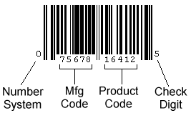
Reading UPC Barcode
Four Areas
Number System
AKA Type of product
0,7 Regular UPC code
Manufacturer Code
Assigned by UCC Council
99,999 possible manufacturers
Product Code
Manufacturer free to assign
99,999 possible products
Check Digit
Notes:
Number System
0 Regular UPC codes
3 Drug/Health related
5 Coupons
7 Regular UPC codes
UCC = Uniform Code Council
99,999 possible manufacturers per number system
Not all manufacturers need 99,999 product codes. Variable length mfg codes = longer than 5 digits.

Slide 8
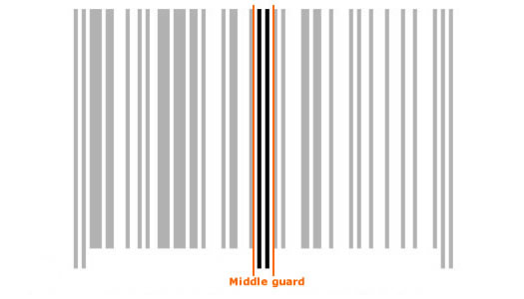
Reading UPC Barcode Guard Pattern
Start
Middle
End
Pattern is bar, space, bar for Start and End
Middle is space, bar, space, bar, space

Slide 9
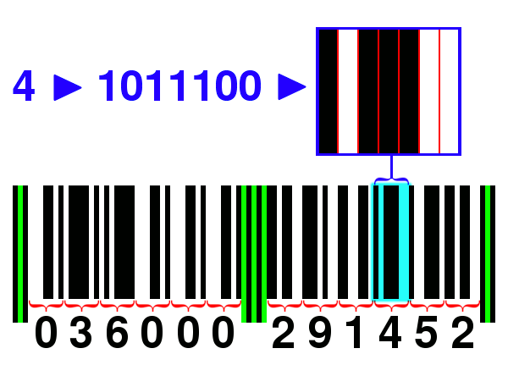
Reading UPC Barcode (Continued)
 | Left Digits Odd Parity S B S B | Right Digit Even Parity B S B S
0 | 3 2 1 1 | 3 2 1 1
1 | 2 2 2 1 | 2 2 2 1
2 | 2 1 2 2 | 2 1 2 2
3 | 1 4 1 1 | 1 4 1 1
4 | 1 1 3 2 | 1 1 3 2
5 | 1 2 3 1 | 1 2 3 1
6 | 1 1 1 4 | 1 1 1 4
7 | 1 3 1 2 | 1 3 1 2
8 | 1 2 1 3 | 1 2 1 3
9 | 3 1 1 2 | 3 1 1 2
Digits a mix of bars and spaces
Also know as modules
Total width is 7 modules
Starting module determined by position in bar code

Slide 10
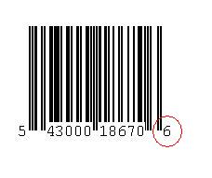
Reading UPC Barcode Check Digit
Last Digit of a UPC
Calculated from other digits by
Adding odd digits, multiply by 3
Add even digits (excluding check digit)
Add the sums
Perform a modulo 10
If result is 0 check digit is 0
Else check digit should be 10 - result
Odd Sum: 5+3+0+1+6+0 = 15 * 3 = 45
Even Sum: 4+0+0+8+7 = 19
Sum Mod 10: 45+19 = 64 % 10 = 4
Check Digit: 10 – 4 = 6

Slide 11
Application Internals
Application is written in Java
XML RPC Client is the only Third party library
Basic user interface

Slide 12
Application Internals – Bar code reader
Difficulty with Android camera
Picture Quality
Lighting
Memory
Types of Thresholding

Slide 13
Difficulty with Android camera
Camera needs to be retrieved and released
Numerous times release wasn’t called correctly
Starting and Stopping preview
Initialization Camera Properties
Out of memory
Supported features

Slide 14
Picture Quality
Take picture
Out of focus
Always blurry
JPEG default picture quality (settable)
Take next preview
Clear
Exactly what was seen on preview
NC21 YCrCb default picture quality

Slide 15
Lighting
Flash modes
Torch
Macro
Bright spots affected Thresholding
Full Image vs Barcode area vs Line we care about
Thresholding techniques (Talk about later)

Slide 16
Memory
Limited
16 MB on 1st gen phones
24 MB on 2nd gen phones
8 megapixel image unable to save as an object in memory.
Database storage based on available internal memory.
Notes:
Internal memory meaning the area it is stored on.

Slide 17
Types of Thresholding
Otsu’s Method
Worked well whole image
Not so well on a single line (expected)
Iterative
Required an initial start threshold value
Always resulted in a local minimum
Modified
Find the first largest peak
Find second largest furthest away from first
Find a low valley between the two
Notes:
Modified uses distance to find the valley instead of foreground/background weight values.
Also had to apply a -1 4 -1 sharpen kernel to the row.

Slide 18
Application Internals - UI
Views are containers
Started with using TableLayout’s
Easy to add new items
Can’t be updated dynamically
Switched to ListView’s
Underlying list adapters allow dynamic change
Notifying of a change must happen on UI thread
Notes:
Containers much like jpanel’s. Combine them to make all kinds of screens.

Slide 19
Application Internals – Web Services
Google
Original plan
Only found shopping related services
WS usage cost money
Amazon
Original backup plan
WS usage cost money
TOS
Notes:
Usage cost money after an initial phase.
TOS – Usage of WS should bring business to Amazon

Slide 20
Application Internals – Web Services
UPCDatabase
Non profit/commercial usage only
Does not have everything
Only basic information
XML RPC
Rotten Tomatoes
Title search only
No series information
Not all information for all movies
Notes:
remote procedure call (RPC) protocol which uses XML to encode its calls and HTTP as a transport mechanism
Series = TV shows, movie collections

Slide 21
Demonstration of the Application

Slide 22
Questions?
Questions?

Slide 23
References
http://www.barcodeisland.com/upca.phtml
http://www.adams1.com/upccode.html
http://www.softwarepractice.org/wiki/UPC-A_Barcode_Standards
http://www.free-power-point-templates.com/cinematography-powerpoint-template/

